Slide 1


Slide 2
Transition
Each old Qcam VI has been replaced with a new SITK® VI. The icons are similar and they have the same inputs and outputs to allow for ease of replacement. Since they have SITK® handles internally, they are able to be used seamlessly with the core SITK® VI’s.
The old Qcam examples will work with the new Vis with only two changes necessary. One needed the data size to be 16 bit unsigned integer instead of 8 bit.
In the trigger example, trigger setup must come before the standard setup. This is the only sequence change needed.

Slide 3
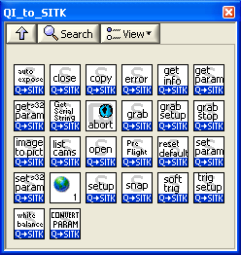
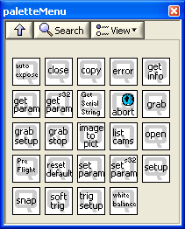
New camera palette and old camera palette

Slide 4
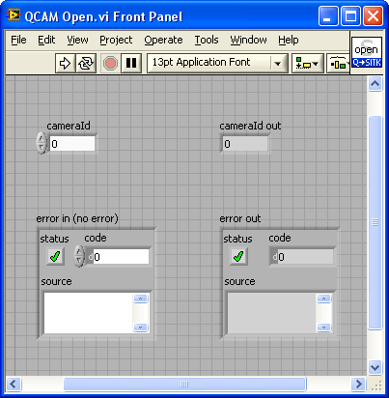
QCAM Open.vi front panel. (same as old VI)

Slide 5
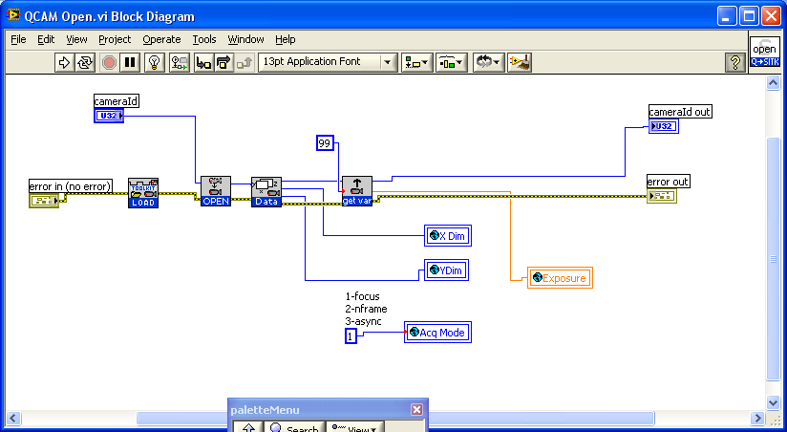
QCAM Open.vi block diagram

Slide 6
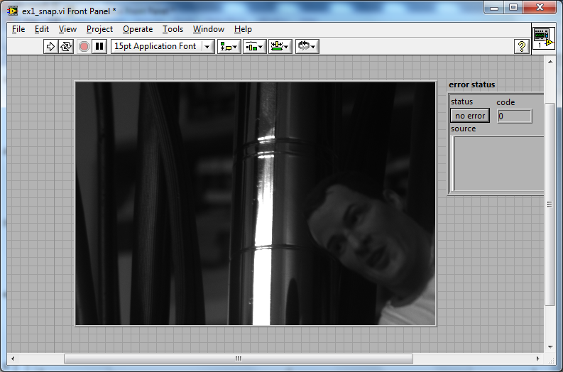
Ex1_snap.vi

Slide 7
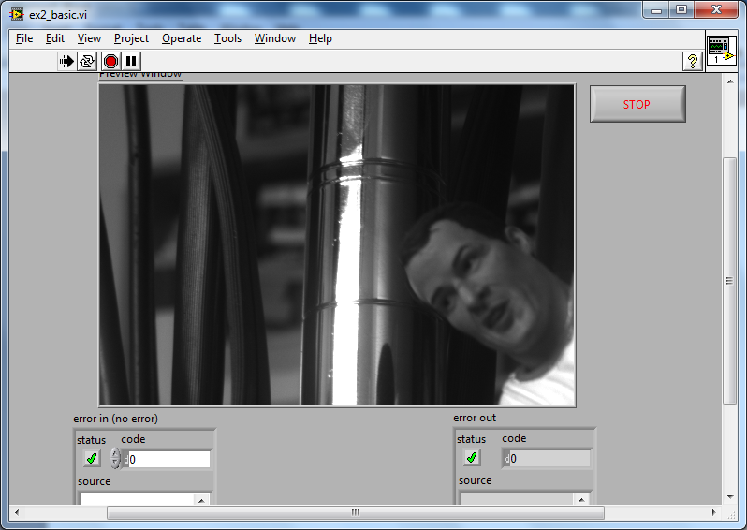
Ex2_basic.vi

Slide 8
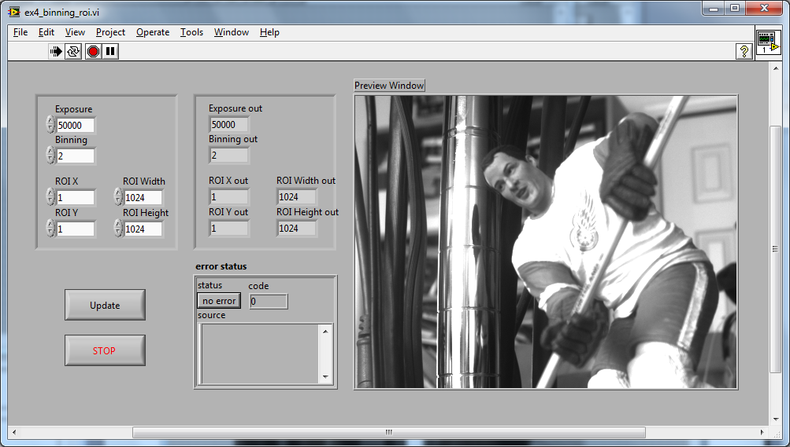
Ex4_binning_roi.vi

Slide 9
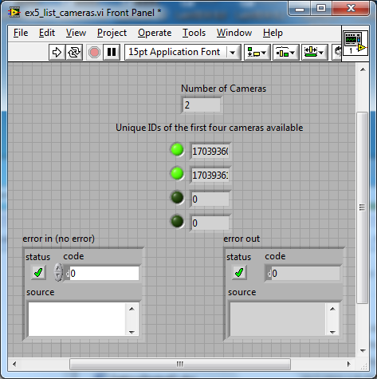
Ex5_list_cameras.vi

Slide 10
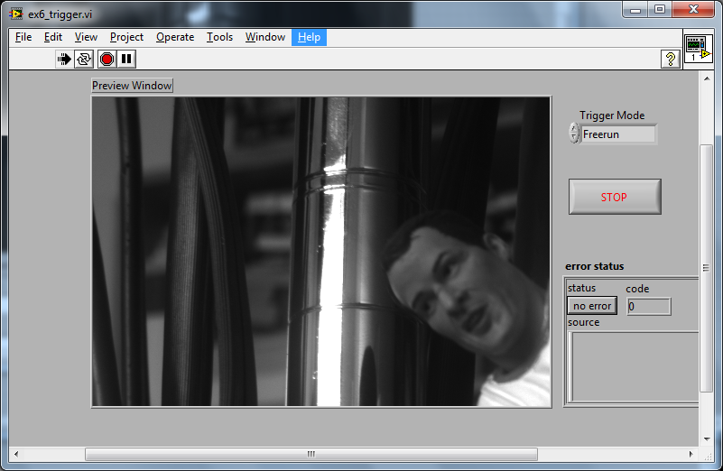
Ex6_trigger.vi

Slide 11
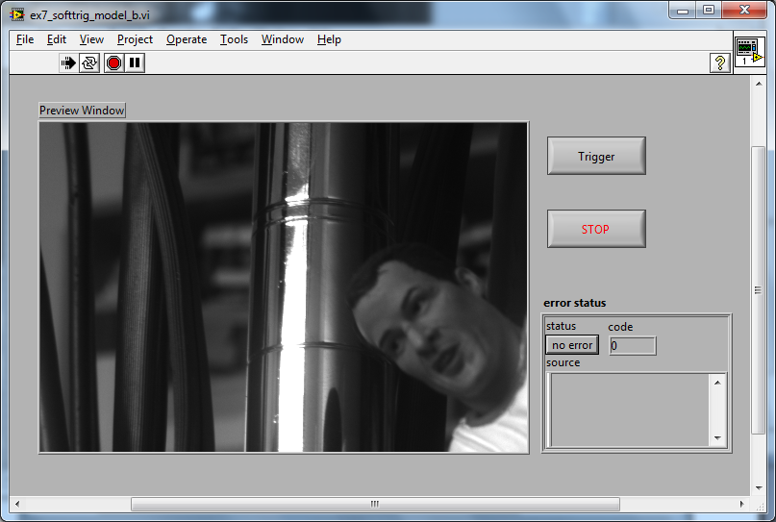
Ex7_softtrig_model_b.vi

Slide 12
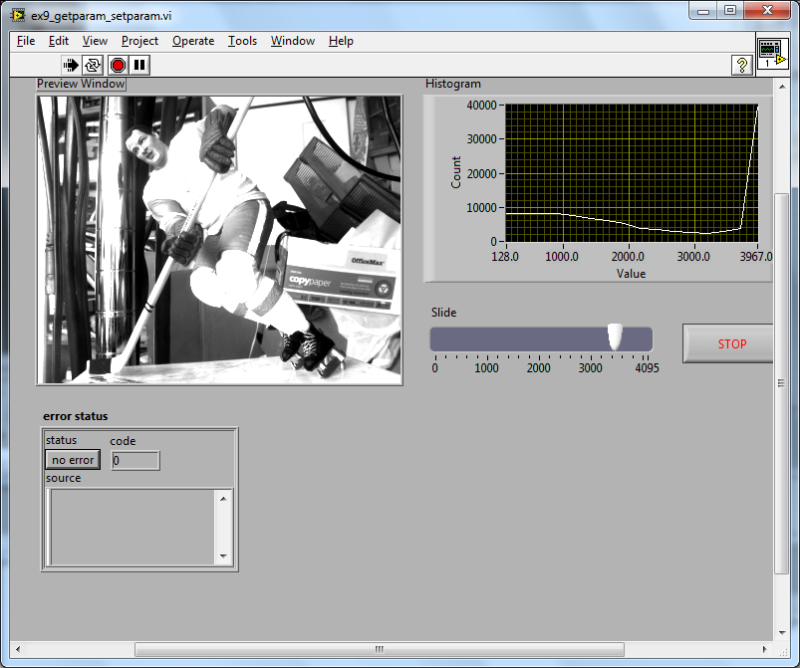
Ex9_getparam_setparam.vi

Slide 13
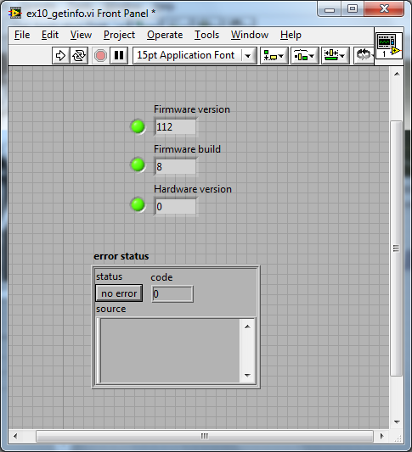
Ex10_get_info.vi

